Slide 1
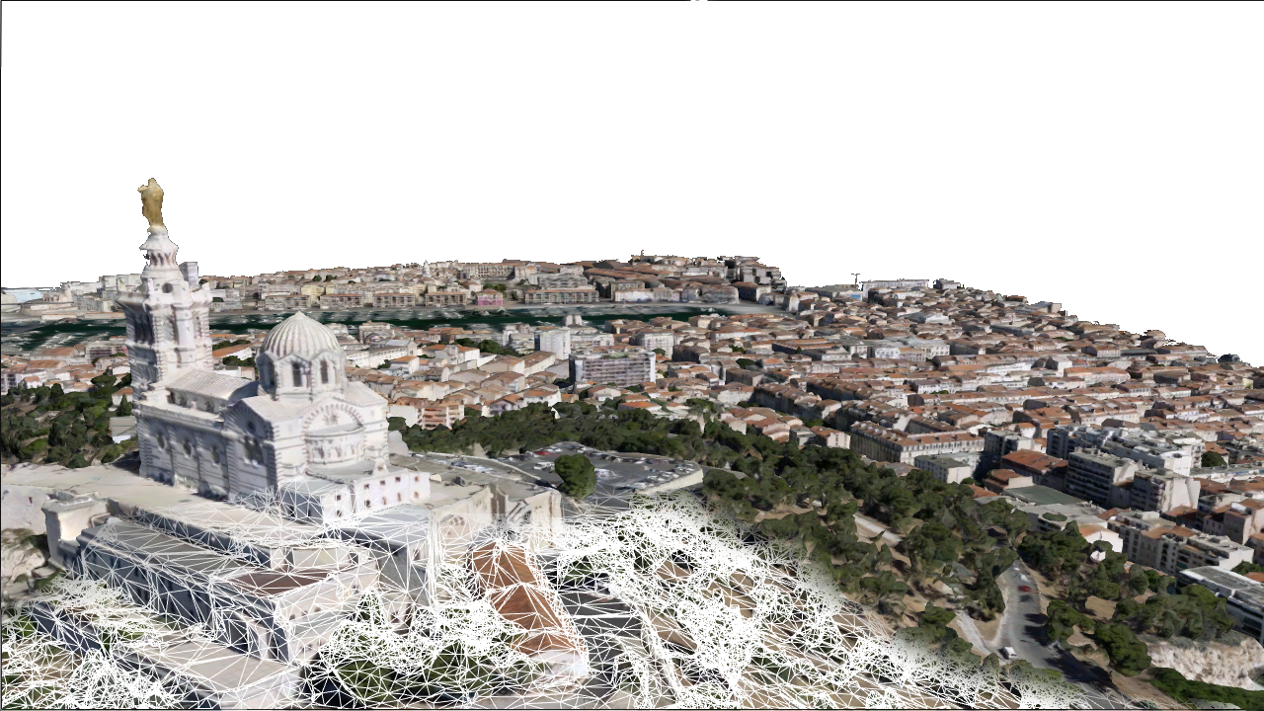
Mesh Scene Layer Performance Improvements
Ronald Poirrier - rpoirrier@esri.com
Notes:
Esri Corporate Template-Dark v3.4
16:9 version – January 29, 2017
For more templates, sample files, and icons, see https://compass.esri.com/resources/presentations/Pages/Main.aspx
To add footer text in Windows
On the Home tab, under Insert, click Text, and then click Header and Footer.
Click the Slide tab, select the Footer check box, and then type the footer text that you want.
Click either Apply or Apply to All.
To add footer text on a Mac
On the View menu, select Header and Footer.
Select the Footer check box and then type the footer text that you want.
Click either Apply or Apply to All.
If footers don't appear on the slides
If footers don't appear on title slides, in the Header and Footer dialog box make sure the Don't show on title slide check box is not selected.
If the footers are missing from other slides, the placeholders for these items might have been removed from specific slide layouts or the slide master.

Slide 2
Motivations
Customers/distributors complained about sale losses due to IM performances
Same IM datasets perform better on competing solutions
Identify and resolve performance issues ahead of Vricon “3D basemap” roll out

Slide 3
Performance goals:
Find the best balance between visual quality and resource consumption
Key resources :
GPU memory
Network bandwidth
Number of draw calls
Visual quality:
Minimize “disappearing” tiles and gaps
Good texel to (screen)pixel ratio
Progressive refinement (avoid pauses/delays )
Refine closer to camera first.

Slide 4
Methology
Find representative IM datasets from several providers
Identify root causes of performance issues
Implement solutions
Measure performance improvements

Slide 5
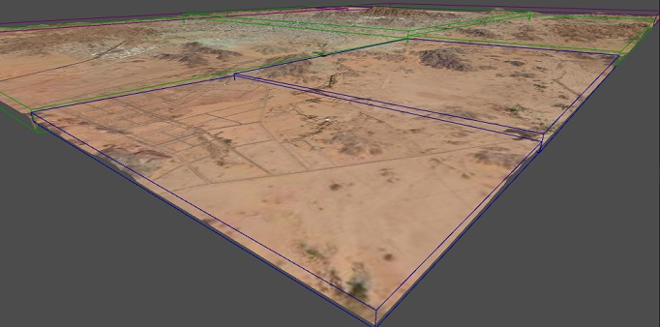
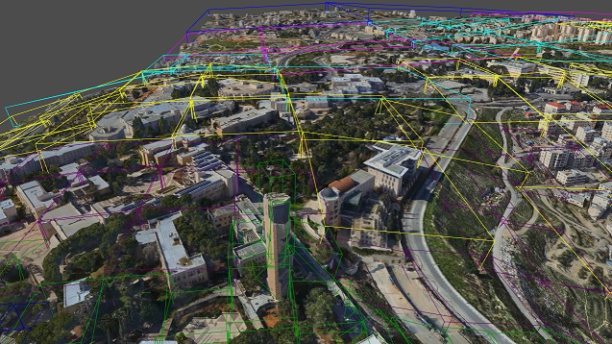
Test Datasets
Vricon: Mecca, Saudi Arabia
~22,000 tiles
~2 GB (jpeg only), ~7.2GB (jpeg+DDS)
Texture size ~1024
Acute 3D: Girona, Spain
~6,800 tiles
~4 GB (jpeg + DDS)
Texture size varies, but usually < 1024
Context Capture: Jerusalem, Israel
~49,000 tiles
~6 GB (jpeg only), 11 GB (jpeg + DDS)
Texture size varies, but usually < 512

Slide 6
Other providers…
Test datasets on \\redarchive2 are either:
Too small (node count, extent) for effective benchmarking (Drone2Map, OSGB)
Have drawing issues (Vexcel)
Won’t draw at all (Skyline, Aerometrex)
But, benchmarking new datasets is easy (SLPK or live Service):
-> Add representative datasets when they become available.
-> Quick turn-around to investigate customer/distributor complains

Slide 7
Performance Issue Analysis

Slide 8
Issue 1: Sub-optimal tiles/LODs selection
Causes:
MBS are not tied enough around mesh ( e.g.“pizza box” shapes)
MBS projected-size doesn’t depend on look angle (close to ground vs. top-down)
Large tiles leads to limited LOD granularity & excessive overhead for partially visible tiles
3rd party IM providers may not write lodSelection metric correctly.
Solutions:
Switch from MBS to OBB
Replace LOD metrics with textureSize information and vertexCount
Mandate smaller tile size
Provide tooling to 3rd party provider to ensure good UX/performances

Slide 9
Oriented Bounding Box
https://esri.box.com/s/nzx67z68h19yrwvwqnk5r29svicyslvy

Slide 10
Implementation: Request pattern and LOD selection
Tile priority : LOD first, then distance.
Node-page priority: bump priority by 1 LOD.
GPU memory budget: Garbage collection heuristic based on LOD, then age.
Always keep visible node ancestry in GPU memory
LOD switching based on screen-pixel/texel ratio
Concurrency per tile not per requests
Threading model: render+cull thread, everything else is async
Swap request_list vs. “traditional” async pattern (i.e. “future/promise” c++11, runtime PPLX, Javascript XMLHttpRequest (Ajax) )

Slide 11
Issue 2: Inefficient communication
Causes:
Traversing the bounding volume tree requires one request per node (chattiness)
Extraneous request (sharedResource)
ArcGIS server inefficiencies/bugs ( REST handler <->CouchDB store)
https://devtopia.esri.com/WebGIS/arcgis-for-server/issues/5296
https://devtopia.esri.com/WebGIS/arcgis-for-server/issues/5318
Solutions:
Group node into pages (paged-access)
Compact Node index JSON: strip redundant information
Replace tree-keys by integer node-ids
Drop sharedResource requests (not used for IM. Will need refactoring for 3D Object)
Server team is working on a fix

Slide 12
Implementation: Paged-access
I3S changes:
Group 64 nodes per page document
Strip redundant info (parent, neighbors) and use implicit resource references
Children IDs store in array ( != PCSL)
Performance Testing:
Current I3S -> Optimized SLPK tool
IO test-bench with adjustable Time-to-first-byte (TTFB)

Slide 13
Current 3DNodeDocument.json (leaf node without OBB)
{
"version": "{b13b9d33-0f0b-413d-bc5f-af6bc67c6861}",
"id": "3-0-0-1-2-0-0-1-0-2-3-2-2",
"level": 14,
"mbs": [
39.66847182390115, 21.262627149132967, 138.55127158371869, 116.12447675184754
],
"lodSelection": [
{
"metricType": "maxScreenThreshold",
"maxError": 464.49790700739015
}
],
"sharedResource": {
"href": "./shared"
},
"featureData": [
{
"href": "./features/0"
}
],
"geometryData": [
{
"href": "./geometries/0"
}
],
"textureData": [
{
"href": "./textures/0_0"
}
],
"parentNode": {
"id": "3-0-0-1-2-0-0-1-0-2-3-2",
"href": "../3-0-0-1-2-0-0-1-0-2-3-2",
"mbs": [
39.668477023526457, 21.263779079831718, 139.35749766391842,243.46394427723499
]
},
"features": null,
"neighbors": [
{
"id": "3-0-0-1-2-0-0-1-0-2-3-2-3",
"href": "../3-0-0-1-2-0-0-1-0-2-3-2-3",
"mbs": [ 39.668484321157457, 21.264825607646465,139.70987085165345, 127.72737785669715 ]
},
{
"id": "3-0-0-1-2-0-0-1-2-0-1-0-0",
"href": "../3-0-0-1-2-0-0-1-2-0-1-0-0",
"mbs": [
39.669773973113244, 21.262620777987344, 140.86407515730735, 172.44740531459757
]
},
{
"id": "3-0-0-1-2-0-0-1-2-0-1-0-1",
"href": "../3-0-0-1-2-0-0-1-2-0-1-0-1",
"mbs": [
39.669783921691248, 21.264820447670893, 140.39121340151823, 180.40225565199452
]
}
],
"children": null
}
Node Object (64 per page)
(with OBB)
"id": 14,
"obb": {
"center": [
35.24185021, 31.79702943, 764.774121
],
"halfSize": [
1894.442749, 822.7074585, 81.25891876 ],
"quaternion": [
0.00248162006, -0.01082093921, -0.008798263967, 0.9998996854
]
},
"textureWidth": 256,
"textureHeight": 128,
"vertexCount": 2310,
"children": [19, 26, 75 ]
}

Slide 14
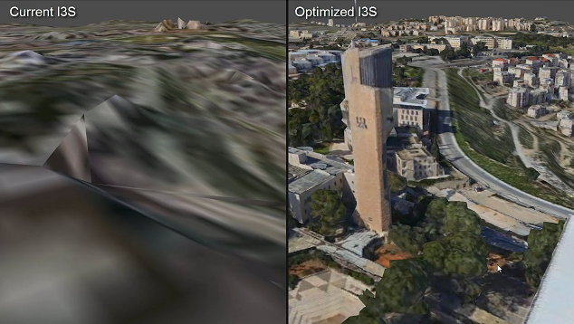
Visual Quality Comparative Video (Jerusalem)
https://esri.box.com/s/nzx67z68h19yrwvwqnk5r29svicyslvy

Slide 15
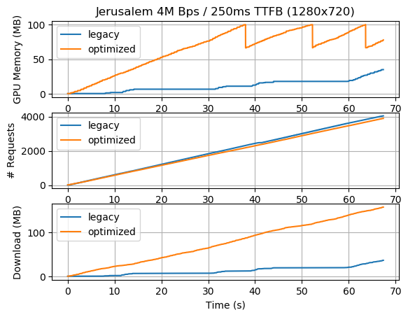
Performance log – Jerusalem :
Current I3S:
TTFB bound
Under-utilized bandwidth
Poor visual quality
Optimized I3S:
Bandwidth bound (good ☺)
Moderate tile GC (~10 sec frequency)
Good visual quality
TTFB bound

Slide 16
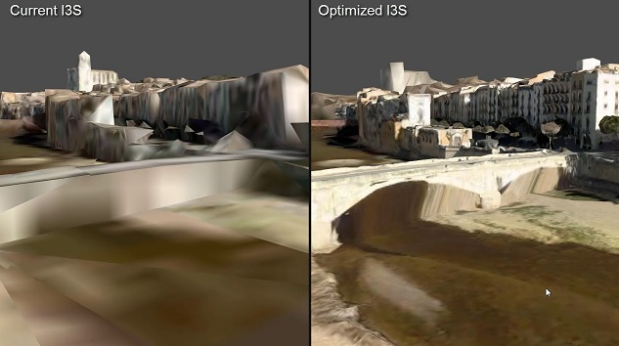
Visual Quality Comparative Video (Girona)
https://esri.box.com/s/1vppvn8zuqmhhtfletxl3ftkc8uxwpdb

Slide 17
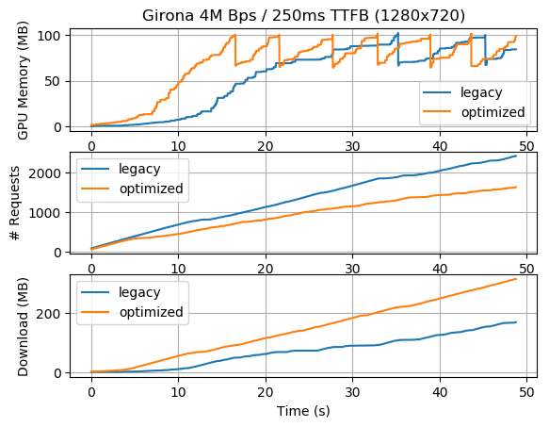
Performance log – Girona:
Current I3S:
TTFB bound (still)
Under-utilized bandwidth
Slow “cold” traversal
Acceptable visual quality
Optimized I3S:
Bandwidth bound (good ☺)
Fast “cold” traversal
Good visual quality
TTFB bound

Slide 18
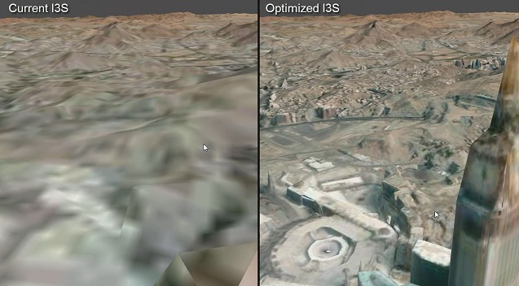
Visual Quality Comparative Video (Mecca)
https://esri.box.com/s/76o8ajl52s8c28sp3enfnjpm1rodzxmf

Slide 19
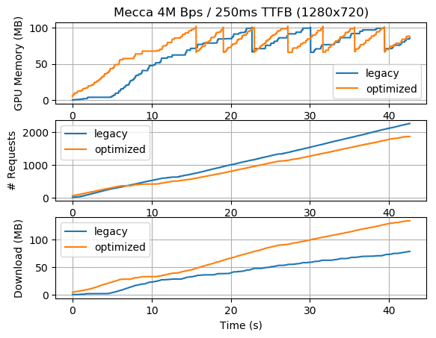
Performance log – Mecca (Vricon):
Current I3S:
Bigger tiles -> less TTFB bound
Under-utilized bandwidth
Slower “cold” traversal
Acceptable visual quality
Optimized I3S:
Bandwidth bound (good ☺)
Fast “cold” traversal
Good visual quality
TTFB bound

Slide 20
Issue 3: Excessive GPU memory consumption
Causes:
JPEG texture stored uncompressed in texture memory
Drawing more tiles than necessary due to Issue 1
Excessive mesh geometry usage (20 bytes per vertex)
Texture compression options:
Geometry: Switch to indexed mesh + 16-bit precision XYZ & UV (4-6 bytes per vertex)
Network compression | GPU compression | Download size | CPU usage | GPU Memory
jpeg | none | lowest | high | highest
jpeg | Block-compressed | lowest | highest | lowest
DDS/ETC2 /PVRTC (with mips) | Block-compressed | highest | negligible | lowest

Slide 21
Issue 3: Excessive GPU memory consumption
The best of both world ?
Low-entropy DXT, then compress to LZMA ?
https://cesium.com/blog/2017/02/06/texture-compression/
Observations:
Seem to improve compression ratio ( 10-50% but with lower texture quality)
Open Source CrunchLib compressor is very slow. Probably not practical for IM.

Slide 22
Implementation: Texture compression
Evaluate bandwidth vs. GPU memory consumption in all 3 scenarios
IO test-bench with adjustable Bandwidth (i.e. bytes per sec)

Slide 23
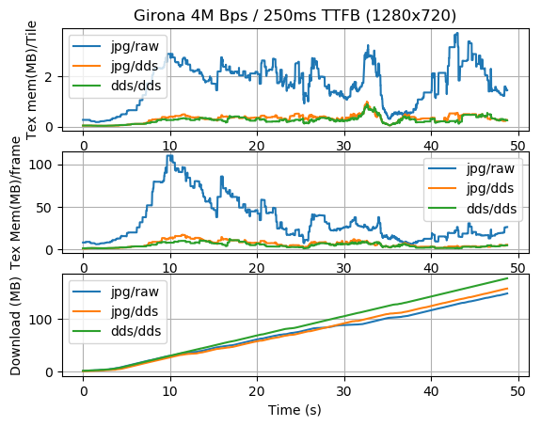
Texture Compression – Girona (Optimized I3S only)
Conclusions:
1:8 saving in texture memory
(1:6 with ETC2)
Bandwidth: dds+gzip close to JPEG !
-> with high quality texture
Very similar visual quality

Slide 24
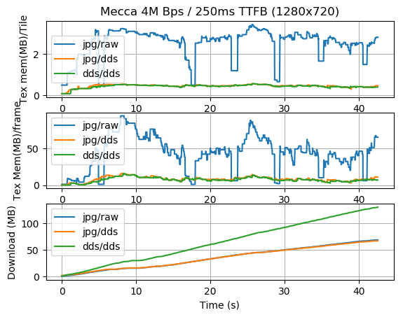
Texture Compression – Mecca (Optimized I3S only)
Conclusions:
1:8 saving in texture memory
(1:6 with ETC2)
Bandwidth: jpeg can compress low quality texture much better
Degraded UX due to frequent GC with uncompressed texture (drop to lower LOD on cache miss)
Good visual quality with compressed texture

Slide 25
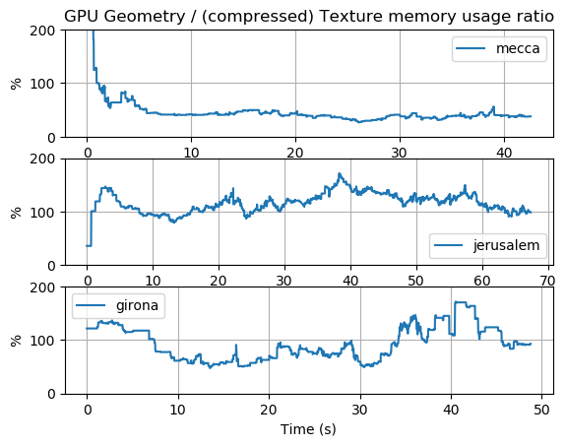
GPU Geometry Compression (Optimized I3S only)
Once we implement texture compression, geometry memory usage become significant !:

Slide 26
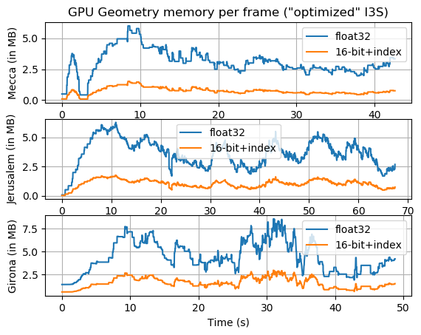
GPU Geometry Compression: results
Conclusions:
Vertex Indexing: Discontinuous UV mapping reduce gains
16-bit quantization :
+ No visual difference
+ Good memory saving
- WebGL support ?
Dataset | Compression Ratio* XYZ index only | Compression Ratio* XYZ+UV index | Compression Ratio* XYZ+UV index+16bit
Girona | 33% | 75% | ~36%
Jerusalem | 33% | 51% | ~30%
Mecca | 33% | 45% | ~28%
* compression ratio compress/original (less is better). All compressed size computed using a 16-bit index

Slide 27
Future Work
Geometry transmission compression (Draco?, predictive mesh compression)
3D Object (mesh-pyramid I3S profile) optimization
BIM Scene layer optimization

Slide 28
Resources
Complete report:
https://devtopia.esri.com/ArcGISPro/i3s-spec/blob/master/design/optimization/integrated_mesh_perfs.md
Comparative videos:
https://esri.box.com/s/pxfbpyslv1uit4svfwvhmzu2wawn18ri
Source code 3D viewer and I3S optimizer (C++)
https://devtopia.esri.com/rona7954/scene-layer-lib/tree/rona7954/mesh
Performance logs (json), fly-through paths (json) and charts (png):
https://devtopia.esri.com/ArcGISPro/i3s-spec/blob/master/design/optimization/logs

